Slide 1

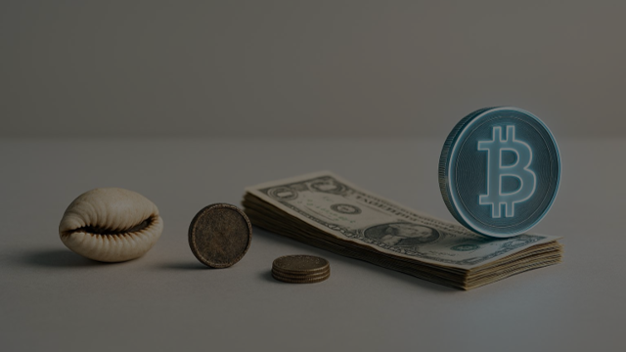
MONEY: THE KEY TO FREEDOM
Notes:
What Is Money? Its Purpose Across Time and Space, From Shells to Digital Cash: The History of Money, Modern Money: Why Cash Fails Over Time Image source: AI-generated

Slide 2
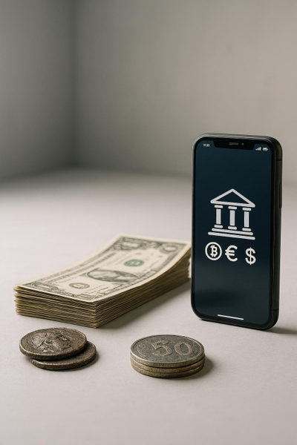
WHAT IS MONEY?
“What is money, really?”
Typical answers: paper, coins, digital numbers.
1. Transfer Value Through Space
Trade with someone far away.
2. Transfer Value Through Time
Save today, use tomorrow.
Notes:
*"What IS money, really?"* (Let them answer - expect: paper, coins, digital numbers) ### **The Two Jobs of Money:** 1. **Transfer value through SPACE** (trade with someone far away) 2. **Transfer value through TIME** (save today, use tomorrow) Image source: AI-generated

Slide 3
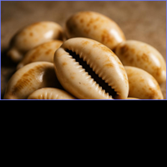
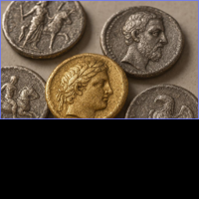
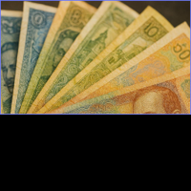
Shells & Mussels
Portable across space; deteriorate over time; abundant supply drives inflation.
Gold & Silver
Stores value through time and space; heavy and hard to divide.
Paper Money
Easy to carry; fails to hold value over time; not accepted everywhere.
HISTORY OF MONEY
Notes:
#### **Shells & Mussels** 🐚 ![Search: "cowrie shells ancient money"](https://www.bing.com/images/search?q=cowrie+shells+ancient+money) - ✅ Portable (space) | ❌ Deteriorate (time) | ❌ Infinite supply (inflation!) #### **Gold & Silver** 🪙 ![Search: "ancient gold coins"](https://www.bing.com/images/search? q=ancient+gold+coins) - ✅ Works through BOTH time AND space! - ❌ Heavy, hard to divide #### **Paper Money** 💵 ![Search: "various world currencies"](https://www.bing.com/images/search? q=world+paper+money+currencies) - ✅ Easy to carry (space) - ❌❌ **FAILS at holding value through TIME** → Inflation! - ❌ Not accepted everywhere (Czech koruna in Japan?) Image source: AI-generated

Slide 4
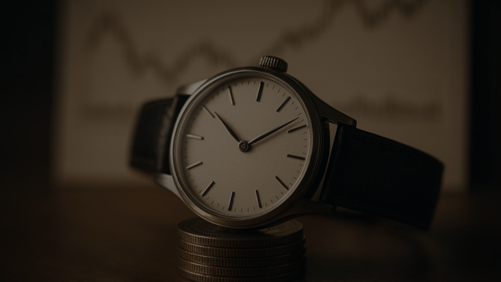
TLDR of this presentation for you, parents, friends: Open broker account, fixed amount every month to S&P 500, as high as possible, before other expenses.
(S&P 500 UCITS ETF (USD) Accumulating (VUAA))
Notes:
Inflation, Time, and Diversification: Three Harsh Truths Image source: AI-generated

Slide 5
Also: Set up eToro account, go to „virtual“ portoflio (100k USD). Meet again in the summer and celebrate winners :)
Notes:
Inflation, Time, and Diversification: Three Harsh Truths Image source: AI-generated

Slide 6
THE POWER OF INVESTING
Notes:
Inflation, Time, and Diversification: Three Harsh Truths Image source: AI-generated

Slide 7
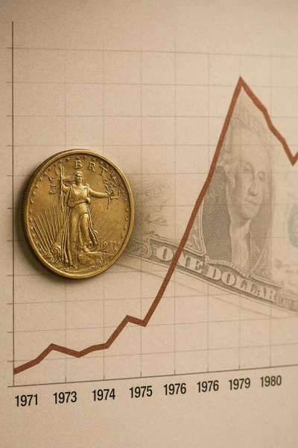
THREE HARSH TRUTHS
WTF Happened In 1971?
1. Inflation Never Stops
August 15, 1971: dollar left gold; inflation rose 4.7% to 13.5% by 1980.
“At 3% inflation, 100 Kč loses 3 Kč yearly—worth 97 Kč in real value”
2. Time Is Your Superpower
At 17, you have ~48 years to 65—5–6 cycles where compounding works hardest.
3. Diversify Across Assets
Own businesses, stocks, and real estate to spread industry, location, and market risks—be smart with assets.
Notes:
#### **1. Inflation Never Stops** 📉 ![Search: "1971 nixon shock inflation chart"](https://www.bing.com/images/search?q=nixon+shock+1971+inflation+rate+chart) **August 15, 1971 - The Nixon Shock** - Nixon: "Dollar no longer backed by gold" - Inflation: 4.7% → 13.5% by 1980[[1]](https://uracentral.com/the-end-of-the-gold-standard-nixons-decision-and-its-impact-on-the-economy/)[[2]](https://insights.som.yale.edu/insights/how-the-nixon-shock-remade-the-world-economy) **Question:** *"At 3% inflation, how much buying power does 100 Kč lose yearly?"* (Answer: 3 Kč - it's worth 97 Kč in real value) #### **2. Time is Your Superpower** ⏰ - At 17, you have 48 years until 65 - That's 5-6 complete market cycles - Compound interest needs TIME #### **3. Diversification Across Asset Classes** 🎯 - Your family might own a business - excellent! - But what if one industry crashes? One location struggles? - Stocks, real estate, businesses - different assets, different risks **Not about being rich or poor - it's about being SMART with assets.** Image source: AI-generated

Slide 8
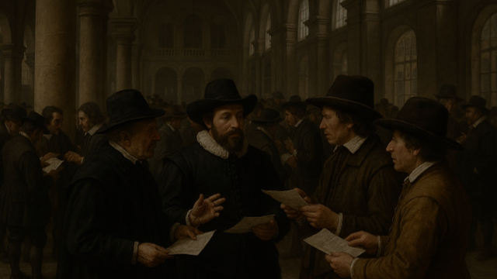
LESSONS FROM MARKET HISTORY
Amsterdam 1602 and the VOC; Newton and the South Sea Bubble — Discipline Over Intelligence
Notes:
The Birth of Stock Markets: Amsterdam 1602 and the VOC, Isaac Newton and the South Sea Bubble: Discipline Over Intelligence Image source: AI-generated

Slide 9
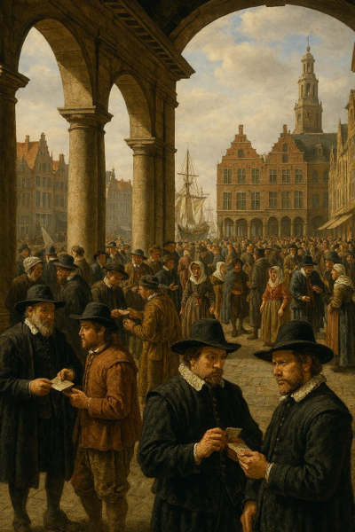
BIRTH OF STOCK MARKETS
The Dutch East India Company (VOC)
Problem: Asia voyages were costly and perilous—lasting 2–3 years with storms, pirates, and disease—too risky for any single merchant.
Solution: The World’s First IPO
Shares sold to the public spread risk across hundreds of investors, letting anyone own a portion of each voyage.
Why It Matters
Established public ownership and risk-sharing—the foundation of modern capital markets.
Notes:
![Search: "Amsterdam stock exchange 1602 painting"](https://www.bing.com/images/search?q=amsterdam+stock+exchange+1602+historical+painting) #### **The Dutch East India Company (VOC)** **The Problem:** ![Search: "Dutch sailing ships spice trade 1600s"](https://www.bing.com/images/search?q=dutch+east+india+company+ships+sailing) - Ships to Asia = EXPENSIVE (2-3 year voyages) - Risk: storms, pirates, disease - ONE merchant couldn't afford it **The Solution: The World's First IPO** - Sell SHARES to the public - Spread risk across hundreds of investors - Anyone could own part of the voyage **Result:** VOC worth ~$7.9 TRILLION in today's money (richest company ever)[[3]](https://www.investopedia.com/ask/answers/08/first-company-issue-stock-dutch-east-india.asp)[[4]](https://www.worldsfirststockexchange.com/2020/10/15/the-worlds-first-ipo/) **Why it matters:** Invented the concept of PUBLIC ownership and risk-sharing Image source: AI-generated

Slide 10
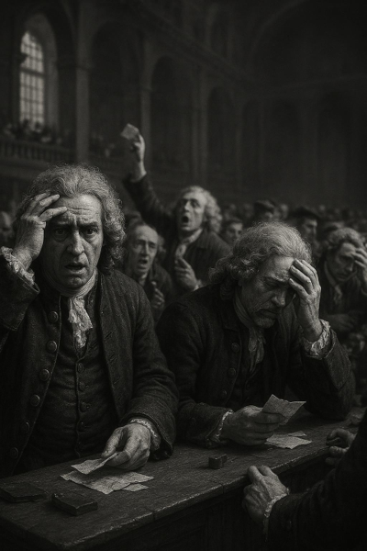
DISCIPLINE OVER INTELLIGENCE
The Story
Genius investor buys South Sea stock, takes profit, then buys back at the top as prices soar. The bubble bursts and he loses a fortune. Even the brightest can be undone by FOMO and crowd mania.
Lesson
Intelligence does not guarantee investment success. Clear rules, risk controls, and emotional discipline consistently beat raw IQ.
Quote
I can calculate the motion of heavenly bodies, but not the madness of people.
Notes:
![Search: "Isaac Newton South Sea bubble"](https://www.bing.com/images/search?q=isaac+newton+south+sea+bubble+loss) **The Story:** - Genius physicist invests in South Sea Company - Makes profit, sells → Smart! - Watches stock keep rising → FOMO - Buys back at TOP - Bubble bursts → Loses £20,000 (~$4M today) - His quote: **"I can calculate the motion of heavenly bodies, but not the madness of people."** **Lesson:** Intelligence ≠ Investment success. Discipline beats IQ. ![Meme: Search "Isaac Newton stock market meme"](https://www.bing.com/images/search?q=isaac+newton+stock+market+bubble+meme) Image source: AI-generated

Slide 11
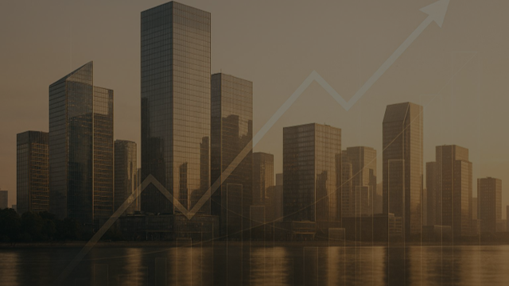
COMPOUND INTEREST
Notes:
Compound Interest: The Secret to Exponential Growth, The Rule of 72: Doubling Your Money, Starting Early: How Time Multiplies Your Wealth, Leverage: Amplifying Gains and Losses Image source: AI-generated

Slide 12
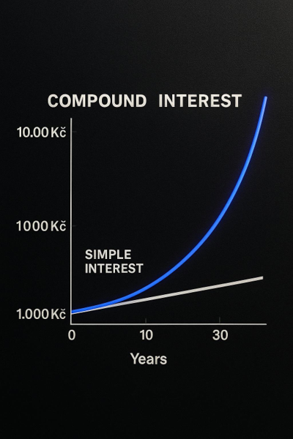
COMPOUND INTEREST GROWTH
Example: 1,000 Kč at 10%
Year 0: 1,000 Kč. Year 10: Simple 2,000 Kč vs. Compound 2,594 Kč. Year 30: Simple 4,000 Kč vs. Compound 17,449 Kč.
Compound = 4.4x More
With the same starting amount, compound growth dramatically outpaces simple interest over time.
Key Statistic
17,449 Kč after 30 years from 1,000 Kč at 10% compound interest.
Notes:
![Search: "compound interest exponential growth"](https://www.bing.com/images/search?q=compound+interest+exponential+growth+chart) **Example: 1,000 Kč at 10%** | Year | Simple Interest | Compound Interest | |------|----------------|-------------------| | 0 | 1,000 Kč | 1,000 Kč | | 10 | 2,000 Kč | 2,594 Kč | | 30 | 4,000 Kč | **17,449 Kč** | **Compound = 4. 4x MORE with same starting amount!** Image source: AI-generated

Slide 13
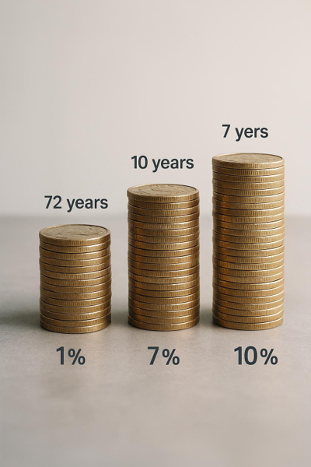
RULE OF 72
Quick Formula
Years to double equals 72 divided by annual return percentage.
Quick Quiz
1. 7% return ≈ 10 years 2. 10% return ≈ 7 years
Savings Insight
3. Bank savings at 1% ≈ 72 years
EXACT calculation? Show your math skills.
Notes:
![Search: "rule of 72 chart"](https://www.bing.com/images/search?q=rule+of+72+investment+chart) ``` Years to Double = 72 ÷ Annual Return % ``` **Quick Quiz:** 1. *"7% return = ?"* (Answer: ~10 years) 2. *"10% return = ?"* (Answer: ~7 years) 3. *"Bank savings 1% = ?"* (Answer: 72 years! 💀) Image source: AI-generated

Slide 14
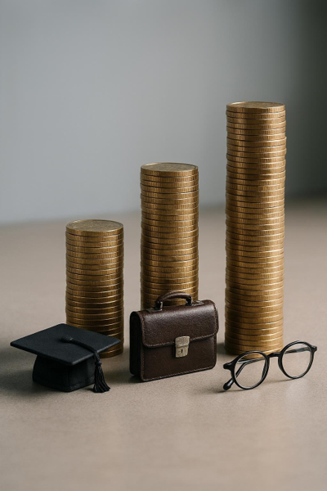
START EARLY MULTIPLY WEALTH
1,000 Kč Monthly at 8%
Consistent contributions compound over decades, turning small sums into meaningful wealth by age 65.
17
Invested: 576,000 Kč • Value at 65: 3,150,000 Kč
27
Invested: 456,000 Kč • Value at 65: 1,430,000 Kč • 10 years earlier = 2.2× more
37
Invested: 336,000 Kč • Value at 65: 612,000 Kč • Time is the secret
Notes:
**Scenario:** 1,000 Kč/month at 8% | Start Age | Total Invested | Value at 65 | |-----------|----------------|-------------| | **17** | 576,000 Kč | **3,150,000 Kč** | | **27** | 456,000 Kč | **1,430,000 Kč** | | **37** | 336,000 Kč | **612,000 Kč** | **10 years earlier = 2.2x more. Time is the secret.** Image source: AI-generated

Slide 15
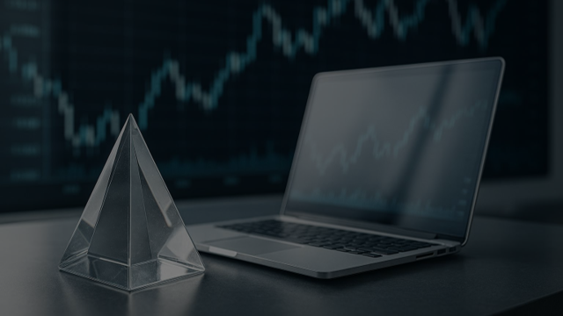
RISK RETURN AND LIQUIDITY
Notes:
The Investment Triangle: Balancing Risk, Return, and Liquidity, Comparing Investments: Savings, Bonds, Stocks, Real Estate, Crypto, Education, Family Business, Types of Risk: Market, Inflation, Liquidity, Political, Geopolitical, Climate Image source: AI-generated

Slide 16
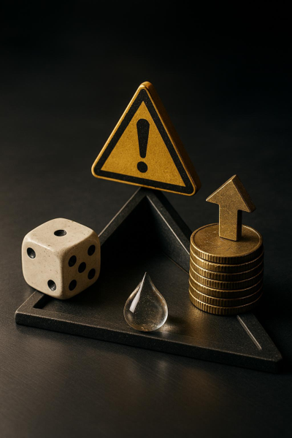
THE INVESTMENT TRIANGLE
Risk
Represents potential loss and volatility — increasing it can raise returns but reduces flexibility.
Return
Potential gains from an investment — higher targets often come with higher risk or lower liquidity.
Liquidity
Ease of converting to cash — maximizing liquidity typically constrains return or elevates risk.
Notes:
![Search: "investment triangle"](https://www.bing.com/images/search?q=investment+triangle+risk+return+liquidity) **The Law: You can't maximize all three! ** Image source: AI-generated

Slide 17

COMPARING INVESTMENT OPTIONS
Put each on the Return – Risk – Liquidity triangle:
Savings
Stocks
Real estate
Education
Family business
Pension insurance
Life insurance
Notes:
| Investment | Return | Risk | Liquidity | |------------|--------|------|-----------| | **Savings Account** | 🔴 Low (1-2%) | 🟢 Very Low | 🟢 Very High | | **Bonds** | 🟠 Low-Med (3-5%) | 🟢 Low | 🟢 High | | **S&P 500 ETF** | 🟢 High (8-10%) | 🟠 Medium | 🟢 High | | **Real Estate** | 🟢 Medium (5-7%) | 🟠 Medium | 🔴 Very Low | | **Your Education** | 🟢🟢 Very High | 🟠 Medium | 🔴🔴 None | | **Crypto** | 🟢🟢/🔴🔴 Extreme | 🔴🔴 Extreme | 🟠 Medium | | **Family Business** | 🟢 High (variable) | 🟠 High | 🔴 Low | Image source: AI-generated

Slide 18

TYPES OF INVESTMENT RISK
Market Risk
Prices can fluctuate sharply (e.g., 2008 saw ~50% declines).
Inflation Risk
Returns may not outpace rising prices, eroding purchasing power.
Liquidity Risk
Assets may be hard to sell quickly at a fair price.
Political Risk
Policy or regulatory changes can impact markets (e.g., Russia 2022).
Geopolitical Risk
Conflicts, sanctions, or instability affect global assets (e.g., Ukraine 2022).
Climate Risk
Physical impacts (flooding) and transition risks (shift away from coal).
"Zero-risk investment?" — It doesn’t exist; even cash faces inflation risk.
Notes:
#### **Market Risk** 📉 - Prices fluctuate (2008: -50%) #### **Inflation Risk** 💸 - Returns don't beat inflation #### **Liquidity Risk** 🏠 - Can't sell quickly #### **Political Risk** 🏛️ - Government rule changes (Russia 2022) #### **Geopolitical Risk** 🌍 - Wars, sanctions (Ukraine 2022) #### **Climate Risk** 🌡️ - Coastal flooding, transition from coal **Question:** *"Zero-risk investment?"* (Answer: Doesn't exist! Even cash has inflation risk) ![Meme: Search "investment risk meme"](https://www.bing.com/images/search?q=investment+risk+management+meme) Image source: AI-generated

Slide 19
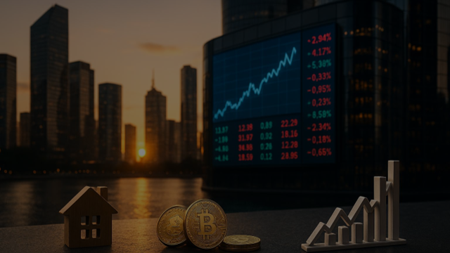
INVESTMENT TYPES
Notes:
Market Terms: Bull vs Bear, Corrections, Lost Decades, Trading vs Investing: Stress, Returns, and Timeframes, Stocks and Equities: Ownership and Returns, ETFs: Diversification Made Easy, Active Funds: Fees and Performance, Dollar Cost Averaging: Investing Without Emotion, Cryptocurrency: High Risk, High Reward, Czech Real Estate: Mortgages, Leverage, and Rental Income, Your Education: The Highest ROI, Family Business: Control, Returns, and Diversification Image source: AI-generated

Slide 20
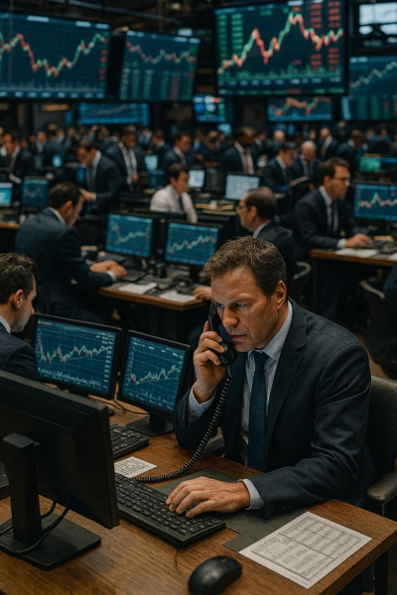
STOCKS AND EQUITIES
What
Own part of a company.
S&P 500 Benchmark
500 largest U.S. companies. Historical return ~10%/year (~7% after inflation). Note the lost decade 2000–2010.
Pros and Cons
Pros: High returns, liquid. Cons: Volatile, requires research.
Notes:
![Search: "stock market long term chart"](https://www.bing.com/images/search?q=stock+market+growth+long+term+chart) **What:** Own part of a company **S&P 500: The Benchmark** - 500 biggest U.S. companies - Historical return: ~10%/year (7% after inflation) - **But: Lost decade 2000-2010! ** **Pros:** High returns, liquid **Cons:** Volatile, requires research Image source: AI-generated

Slide 21

ACTIVE FUNDS: FEES & PERFORMANCE
The Dirty Secret
80–90% of active funds fail to beat low-cost index funds over 15+ years.
Fee Impact
100K Kč for 30 years: 8% with 0.1% fee → 985K Kč; 7% with 1% fee → 761K Kč. That’s 224K Kč lost to fees.
Key Statistic
Most active funds underperform net of fees; costs compound against your returns.
Notes:
![Search: "active vs passive performance"](https://www.bing.com/images/search?q=active+vs+passive+fund+performance+comparison) **The Dirty Secret: 80-90% FAIL to beat index funds over 15+ years** **Fee Impact:** - 100K Kč at 8% for 30 years = 985K Kč (0.1% fee) - Same at 7% = 761K Kč (1% fee) - **224K Kč lost to fees!** ![Meme: Search "active fund fees meme"](https://www.bing.com/images/search?q=active+fund+manager+fees+meme)

Slide 22
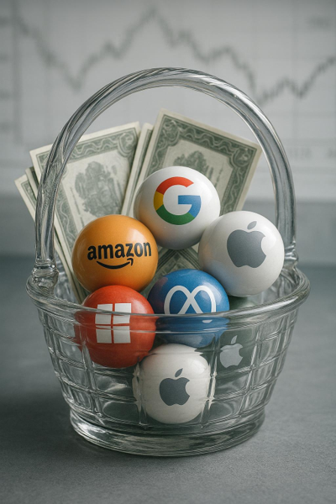
ETFs: DIVERSIFICATION MADE EASY
What
A single ETF holds a basket of stocks; e.g., VWCE includes about 3,500 global companies.
Returns
Historically around 7–12% per year, depending on market cycles and allocation.
Pros
Instant diversification, very low fees (≈0.03–0.20%), and simple for beginners.
Notes:
![Search: "ETF diversification"](https://www.bing.com/images/search? q=etf+diversification+illustration) **What:** Basket of stocks in one package **Example:** VWCE = 3,500 global companies **Returns:** 7-12%/year historically **Pros:** - ✅ Instant diversification - ✅ Low fees (0.03-0.20%) - ✅ Perfect for beginners **Warren Buffett:** "Buy low-cost S&P 500 index fund" Image source: AI-generated

Slide 23
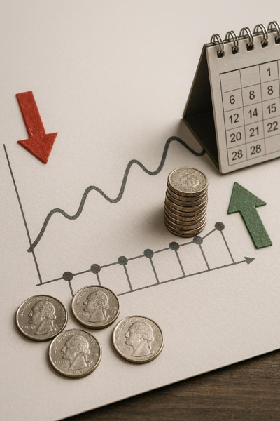
DOLLAR COST AVERAGING
Strategy
Invest a fixed amount every month regardless of price.
Example
1,000 Kč/month → M1: 100 price, buy 10; M2: 80 price, buy 12.5; M3: 110 price, buy 9.
Why It Works
Removes emotion, automates investing, and buys more when prices drop.
Notes:
![Search: "DCA chart"](https://www.bing.com/images/search?q=dollar+cost+averaging+illustration) **Strategy:** Invest fixed amount monthly regardless of price **Example: 1,000 Kč/month** - Month 1: Price 100 → Buy 10 shares - Month 2: Price 80 (crash!) → Buy 12. 5 shares - Month 3: Price 110 → Buy 9 shares **Result: You bought MORE when cheap! ** **Why DCA is Perfect:** - ✅ Removes emotion - ✅ Automates investing - ✅ Beats "lost decades" ![Meme: Search "DCA vs timing market"](https://www.bing.com/images/search?q=dca+vs+timing+market+meme) Image source: AI-generated

Slide 24

EDUCATION: HIGHEST ROI
Highest ROI For Most People
University grads earn ~40% more over a lifetime; typical public cost in CZ is ~200K Kč; lifetime difference can exceed 4M Kč.
Earnings And Cost Snapshot
Strong pay premium relative to modest upfront tuition and fees demonstrates high return on investment.
Caveats And Liquidity
Education has zero short‑term liquidity; outcomes vary widely by field of study.
Notes:
**Highest ROI for most people! ** - University grad earns ~40% more over lifetime - Cost in CZ: ~200K (public) - Lifetime difference: 4M+ Kč **But:** Zero liquidity, field matters! Image source: AI-generated

Slide 25
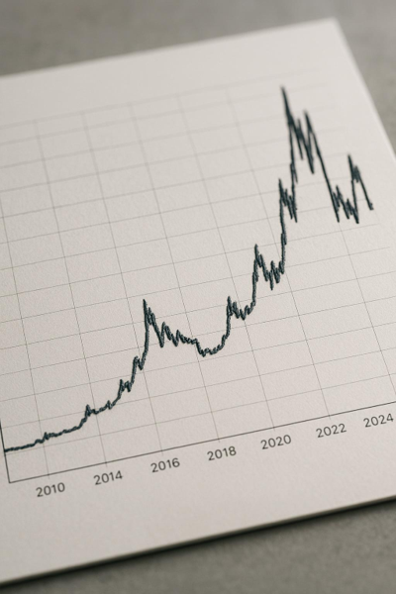
CRYPTOCURRENCY: HIGH RISK HIGH REWARD
Bitcoin Journey
2010: $0.08 • 2021: $69,000 • 2022: $16,000 • 2024: ~$40,000+
Pros
Potential huge gains; decentralized
Cons
Extremely volatile; regulatory risk; scams
Advice
Only 1–5% of portfolio; only money you can lose; do deep research
Notes:
![Search: "Bitcoin price history"](https://www.bing.com/images/search?q=bitcoin+price+chart+history) **Bitcoin Journey:** - 2010: $0.08 - 2021: $69,000 - 2022: $16,000 - 2024: ~$40,000+ **Pros:** Potential huge gains, decentralized **Cons:** Extremely volatile, regulatory risk, scams **Advice:** - Only 1-5% of portfolio - Only money you can LOSE - Do deep research ![Meme: Search "crypto volatility meme"](https://www.bing.com/images/search?q=cryptocurrency+investor+emotional+rollercoaster+meme) Image source: AI-generated

Slide 26
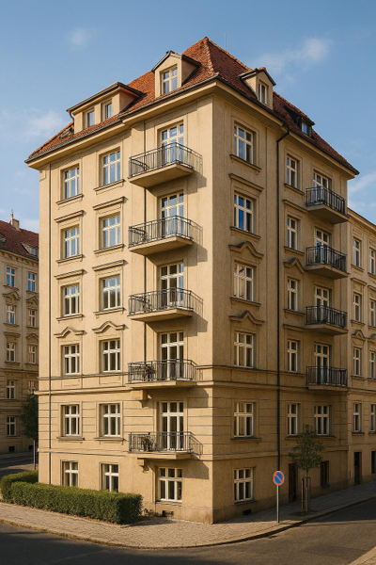
CZECH REAL ESTATE OVERVIEW
Buy to Live
Mortgage rates ~5–6% (2024); interest is tax-deductible; functions as disciplined, forced savings over time.
Buy to Rent
Prague 2+kk ~5M Kč; rent ≈ 20K/month (240K/year); gross yield ~4.8%; net yield typically 3–4% after costs.
Leverage & Risks
Example: 3M property; 600K down; 2.4M mortgage. +10% price → +50% equity; −10% price → −50% equity. Pros: tangible, leverage, rental income, tax benefits. Cons: illiquidity, maintenance, tenants, location risks.
Notes:
![Search: "Prague real estate"](https://www.bing.com/images/search?q=prague+real+estate+apartment+building) **Buy to Live:** - Mortgage rates: ~5-6% (2024) - Tax deduction on interest - Forced savings **Buy to Rent:** - Prague 2+kk: ~5M Kč - Rent: 20K/month = 240K/year - Gross yield: 4. 8% - Net (after expenses): 3-4% **Leverage Example:** - 3M property, 600K down, 2.4M mortgage - +10% property value → **+50% your equity** - -10% property value → **-50% your equity** **Pros:** Tangible, leverage, rental income, tax benefits **Cons:** Illiquid, maintenance, tenant problems, geographic/climate risk Image source: AI-generated

Slide 27

FAMILY BUSINESS STRATEGY
IF YOUR FAMILY HAS ONE
✅ Direct control • ✅ High potential returns • ✅ Keep wealth in family
BUT
❌ All eggs in one basket • ❌ Industry-specific risk • ❌ Geographic concentration
SMART MOVE
Own the business and diversify into broad-market stocks and ETFs for balanced risk.
Notes:
**If your family has one:** - ✅ Direct control - ✅ High potential returns - ✅ Keep wealth in family **But:** - ❌ All eggs in one basket - ❌ Industry-specific risk - ❌ Geographic concentration **Smart move:** Own business AND diversify into stocks/ETFs Image source: AI-generated

Slide 28
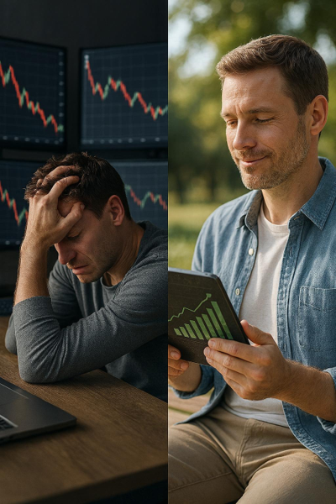
TRADING VS INVESTING
Timeframes
Trading focuses on daily or weekly moves. Investing compounds over years and decades.
Stress Levels
Trading is high stress with constant monitoring. Investing is low stress and patient.
Outcomes & Commitment
Most traders lose money and it feels like a full‑time job. A majority of long‑term investors win—often passively. Even Isaac Newton struggled with trading.
Notes:
| **Trading** | **Investing** | |-------------|---------------| | Daily/weekly | Years/decades | | High stress | Low stress | | 90% lose money | 70%+ make money | | Full-time job | Passive | **Isaac Newton tried trading. Didn't work. ** ![Meme: Search "day trading vs investing meme"](https://www.bing.com/images/search?q=day+trading+vs+long+term+investing+meme) Image source: AI-generated

Slide 29
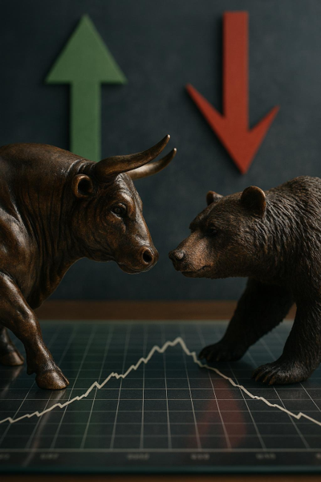
MARKET TERMS OVERVIEW
Bull Market
Prices trend higher over time; example period 2010–2020.
Bear Market
Broad decline of 20% or more; example drawdown in 2022.
Correction
Typical 10–20% pullback within an ongoing trend; common and healthy.
Lost Decade
A prolonged period with flat or negative returns; example 2000–2010 S&P 500.
Notes:
![Search: "bull vs bear market"](https://www.bing.com/images/search?q=bull+bear+market+chart+comparison) - **Bull Market** 🐂 - Prices rising (2010-2020) - **Bear Market** 🐻 - Prices falling 20%+ (2022) - **Correction** - Temporary 10-20% drop (normal!) - **Lost Decade** - Zero returns (2000-2010 S&P 500) Image source: AI-generated

Slide 30

YOUR INVESTING ACTION PLAN
Notes:
Step-by-Step Blueprint: Start Small, Open Brokerage, Pick an ETF, Automate, Learn More, Asset Allocation by Age: Building a Portfolio for Life Image source: AI-generated

Slide 31

STEP-BY-STEP INVESTING BLUEPRINT
1. Start Small
Invest 500–1,000 Kč monthly. Focus on consistency over size to build the habit.
2. Open Brokerage
Patria, XTB, or Interactive Brokers. Have ID, bank account, and parent permission if under 18.
3. Pick ETF & Automate
Choose S&P 500 or a worldwide index, max~0.20% fee. Set monthly auto-invest. Learn more: r/eupersonalfinance,
Notes:
#### **1. Start Small** 🐣 - 500-1,000 Kč/month - Consistency beats big amounts #### **2. Open Brokerage** 🏦 - Trade Republic, XTB, Interactive Brokers - Need: ID, bank account, parent permission (under 18) #### **3. Pick ONE ETF** 📦 - VWCE (Vanguard All-World) - CSPX (S&P 500) - Fee: ~0.20%/year #### **4. Automate** 🤖 - Monthly automatic investment - Set and forget #### **5. Learn More** 📚 - r/eupersonalfinance - YouTube: Graham Stephan, Plain Bagel - Books: "Simple Path to Wealth" Image source: AI-generated

Slide 32

KEY TAKEAWAYS & WRAP-UP
Notes:
Essential Lessons: Time, Compound Interest, Diversification, Fees, DCA, Leverage, Learning, Quiz and Discussion: Test Your Knowledge and Think Critically, Closing Inspiration: Why Starting Now Matters Most Image source: AI-generated

Slide 33
TLDR of this presentation: Put fixed amount (DCA) every month to S&P 500 ETF, as high as possible, before other expenses.
Notes:
Inflation, Time, and Diversification: Three Harsh Truths Image source: AI-generated

